Slide 1
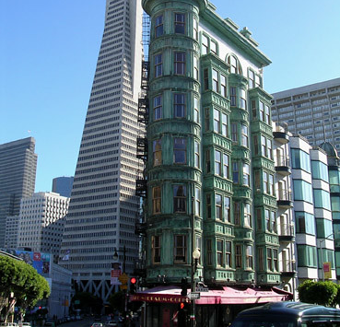

Analysis of San Francisco Salaries

Slide 2

Introduction
The idea of analyzing the San Francisco Salaries dataset to understand income inequality and factors influencing promotions is compelling for several reasons. Here's why we choose this project:
Real-world relevance: The project tackles a real-world issue of income inequality in a specific context (San Francisco City).
Data analysis skills: By working with the San Francisco Salaries dataset, we can develop and enhance our data analysis skills.
Machine learning applications: Students can go beyond descriptive analysis and delve into predictive modeling. By building machine learning models, they can explore how different attributes (such as job title, experience, etc.)
Societal impact: Income inequality is a pressing concern in many societies.

Slide 3
OBJECTIVES
Data quality and preprocessing: The dataset may contain missing values, outliers, or inconsistencies that need to be addressed before analysis. Students may need to handle data cleaning, imputation, and normalization to ensure accurate and reliable results.
Data complexity and size: The dataset could be large and complex, making it challenging to process and analyze. Students may need to optimize their code, use efficient algorithms, or consider working with a subset of the data to manage computational resources.
interpretation: Understanding the meaning and context of the data variables may require domain knowledge isco city. Students may need to consult external resources or seek guidance to interpret the data correctly.

Slide 4
OBJECTIVES
Statistical analysis and modeling: Analyzing income inequality and exploring factors influencing promotions may involve statistical techniques and machine learning models. Students may face challenges in selecting the appropriate methods, validating their models, and interpreting the results accurately.
Visualization and communication: Presenting the findings effectively through visualizations and reports is crucial. Students may need to develop skills in data visualization tools, storytelling, and effectively communicating complex insights to a non-technical audience.
Ethical considerations: Dealing with sensitive information like salaries raises ethical considerations. Students should ensure data privacy, handle the information responsibly, and consider the implications of their analysis on individuals and organizations.

Slide 5
EXPLORATORY DATA ANALYSIS (EDA)
We had a dataset of 312.882 entries of people of different professions from the city of San Francisco.
The number of variables was 9 for each entry
There are some variables with character which we converted to numerical values.
For example, we encoded both JobTitle and Gender, to be able to use them in our models
The data cleaning was performed to omit or modify the fields with “Not provided” status or “NA” fields.

Slide 6
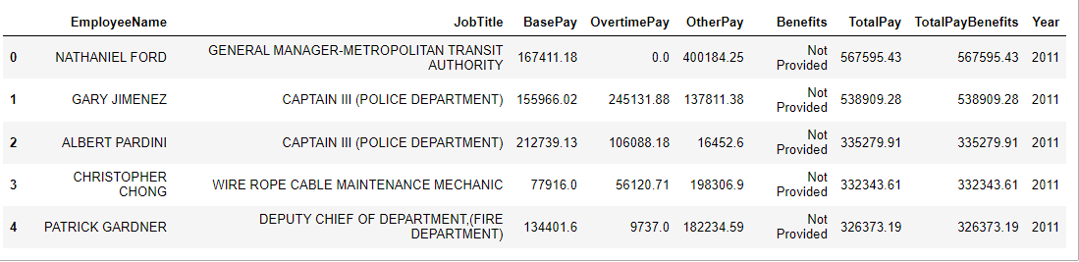
FEATURES WE WORKED ON

Slide 7
Data quality and preprocessing
We had some missing values like in the benefits column, the year 2011 was all missing from the data, we handled that by taking the average of all employees in all years and filling in that missing value with it.
We also removed all outliers from the data, so it doesn’t affect our models later on.
There were some negative values in some columns in the dataset which doesn’t make sense because no column in the table can be negative, so we removed all entries with negative values.

Slide 8
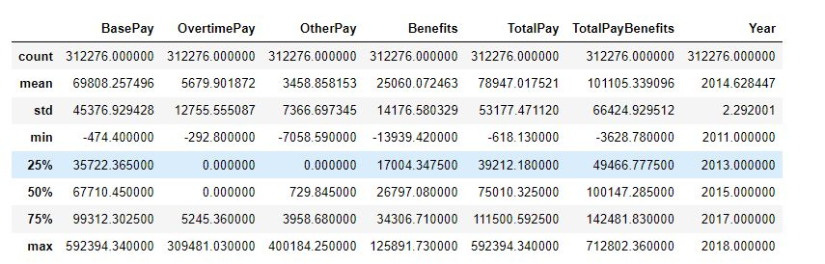
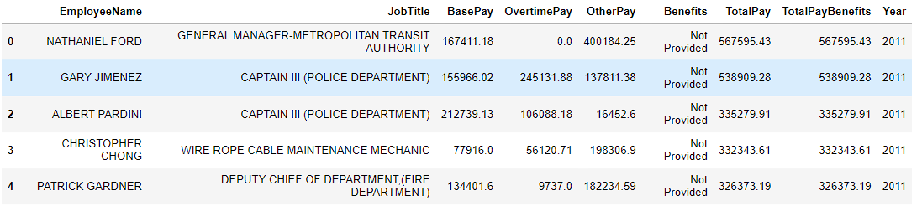
Data before cleaning

Slide 9
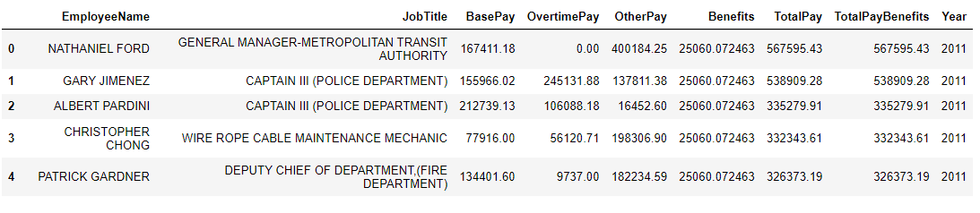
Data after cleaning, clean hah ☺

Slide 10
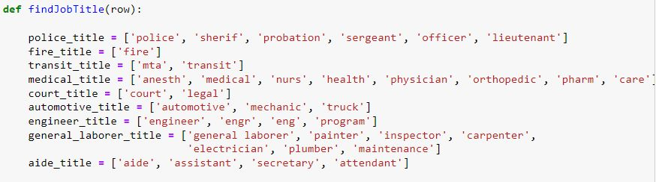
Data complexity and size JobTitle categorization
Here we had to simplify the number of jobs we had, one way to
does it was to generalize all similar jobs into one category as follows?

Slide 11
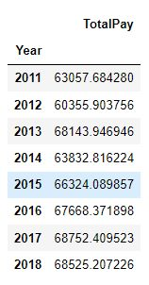
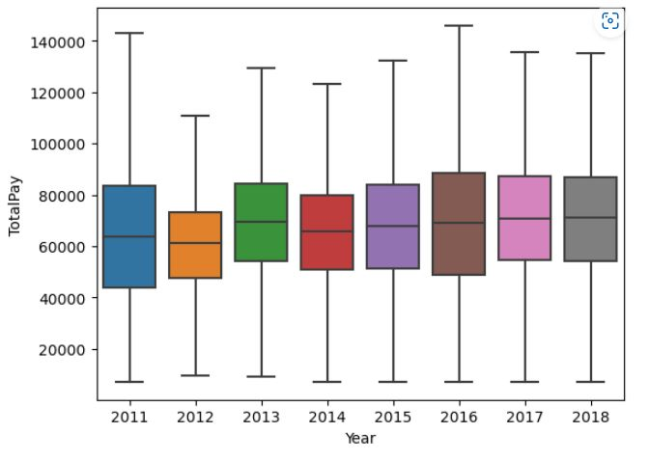
Aggregating Salary Data
Once you have the 'GeneralJobTitle' column, you can use it to calculate the average TotalPay for all employees.

Slide 12
Interpretation and References
We found the previous function on a website called Kaggle https://www.kaggle.com/mevanoff24/data-exploration-predicting-salaries
It was helpful because we didn’t need to write it from scratch
using this categorization, we can start to visualize the data and get some
insights that can help us to study the relationships between our features,
therefore, we started to interpret the data.

Slide 13
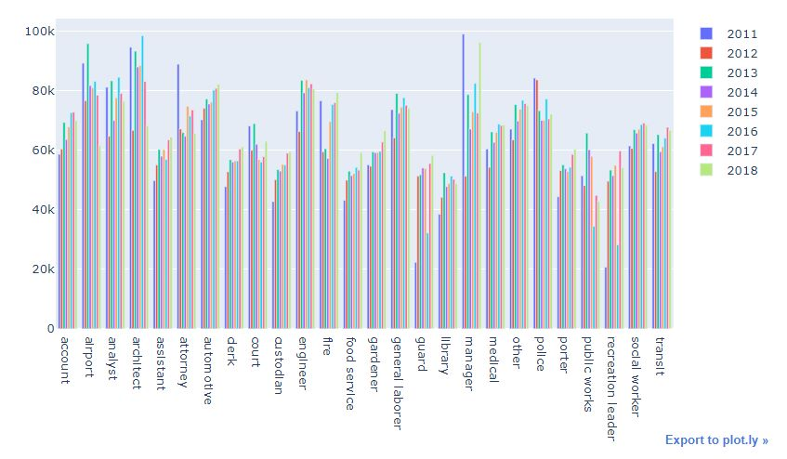
Some visualizations to get insights into the data
Average total pay for all JobTitles for each year

Slide 14
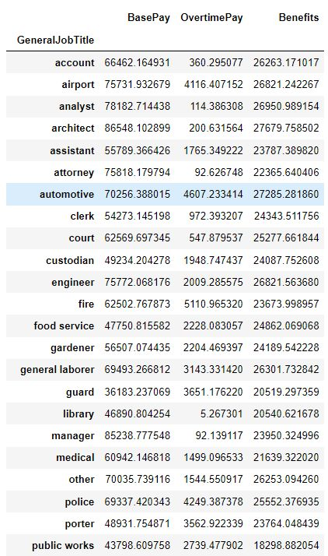
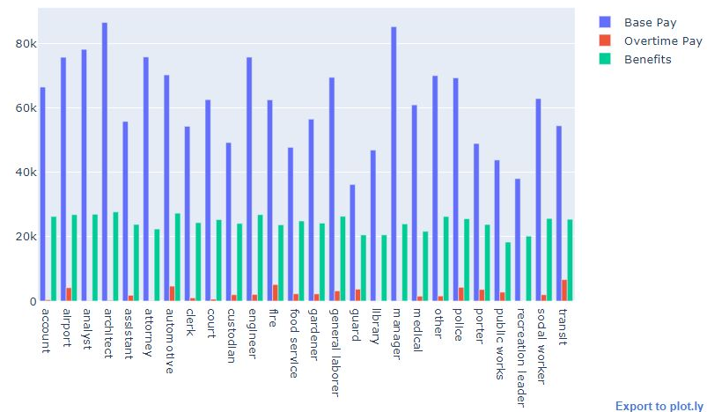
Some visualizations to get insights into the data

Slide 15
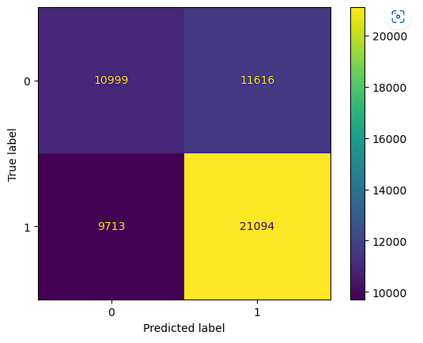
Statistical analysis and modeling Random Forest-Algorithm
We used a random forest algorithm to predict employee’s “Gender” based on the predictors
OverTimePay, OtherPay, Benefits, TotalPay, TotalPayBenefits
And here is the confusion matrix for the model
We can easily identify the accuracy of the model
which is about 60 percent.

Slide 16
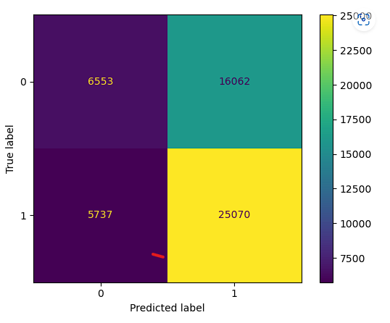
Statistical analysis and modeling Logistic regression algorithm
Here we try to predict the employee’s gender based on all other features in the dataset
Same as before
the accuracy here seems to be 60 percent.

Slide 17

Thank you!❤️

